Slide 1
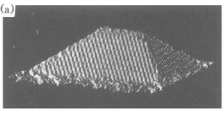
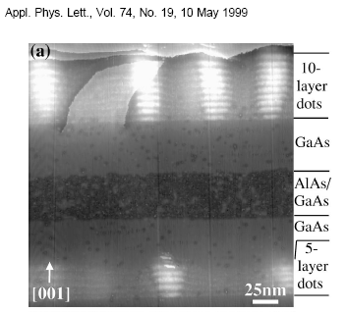
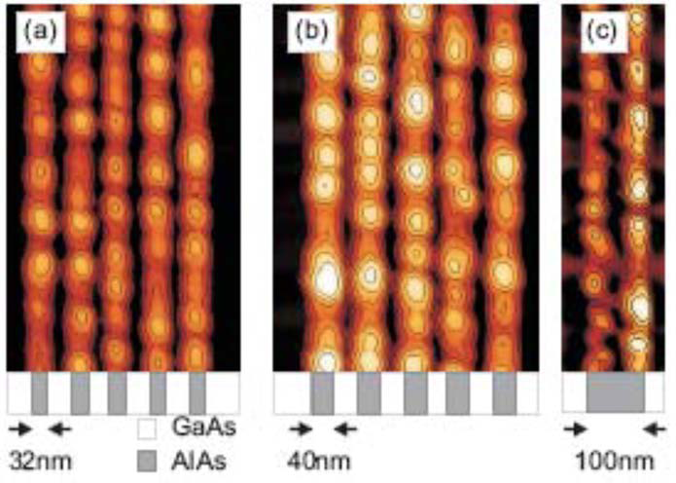
Strain Dependence of Microscopic Parameters and its Effects on Ordering during Epitaxial Growth
Christian Ratsch, UCLA
Institute for Pure and Applied Mathematics, and Department of Mathematics
Collaborators: Xiaobin Niu, Peter Smereka, Jason DeVita.
Motivation: strain induces ordering.
Self-Organized hut formation Ge/Si(001)
Horizontal ordering of quantum dots:
Vertical ordering of quantum dots: Al_{x}Ga_{1-x}As system
InAs on AlGaAs
Y.-W. Mo et al., PRL 65 (1990)
E. Uccelli et al., Nanotech. 19 (20008)
B. Lita et al., APL 74, (1999)
Goal: Develop a kinetic model that correctly includes strain!

Slide 2
How do we include strain in a growth model?
Build a model that includes the above processes.
  Straightforward in an atomistic model (KMC)
  Tricky but possible in continuum type models, or island dynamics (level sets)
Every process can have a different rate at different location (because of local strain)
Our approach
  Calculate the strain field at every time step of the simulation
  Adjust rate for every process (at every location) based on local strain
  Rates are based on density-functional theory calculations (pre-computed)

Slide 3
Outline
Use density-functional theory (DFT) to calculate strain dependence of microscopic parameters.
The level-set formalism to model epitaxial growth.
Ordering in the submonolayer growth regime.
Ordering of stacked quantum dots.

Slide 4
Computational Details of DFT Calculations
We use the FHI-AIMS package.
V. Blum et al., Comp. Phys. Comm. 180, 2175 (2009).
This code uses numeric atom-centered basis sets.
GGA is used for exchange correlation (PBE parameterization).
Periodic supercells with 6 layers that are fully relaxed.
  Model system: Ag/Ag(100)

Slide 5
Strain Dependence for Adatom Diffusion for Ag on Ag(100)
15 meV/ % misfit
In agreement with Yu and Scheffler, PRB 56, R15569 (1997)

Slide 6
Strain Dependence for Dimer Dissociation for Ag on Ag(100)
15 meV/ % misfit

Slide 7
Strain Dependence for Edge Diffusion for Ag/Ag(100)
20 meV/ % misfit

Slide 8
Strain Dependence for Adatom Detachment for Ag/Ag(100)
-25 meV/ % misfit
20 meV/ % misfit
Transition site matters!

Slide 9
Outline
Use density-functional theory (DFT) to calculate strain dependence of microscopic parameters.
The level-set formalism to model epitaxial growth.
Ordering in the submonolayer growth regime.
Ordering of stacked quantum dots.

Slide 10
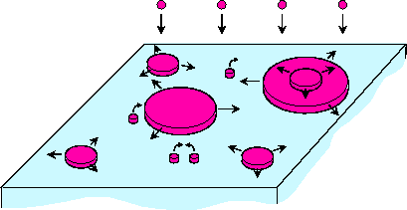
How Do We Incorporate These Strain Dependent Parameters into a Growth Model?
replace
Atomistic picture
(i.e., kinetic Monte Carlo)
Time step: O(10⁻⁶s)
Island dynamics
Use level set method to track island boundaries
Time step: O(10⁻² – 10⁻³s)
F
v
D
Assume that material that is deposited has a bigger lattice constant.
Solve elastic equations at every time step (expensive!).
This gives us strain (i.e., effective lattice constant) at every lattice site at every time step.
Parameterize strain dependence of relevant parameters in growth model with DFT results.

Slide 11








The level set method: schematic
Level set function ϕ
Surface morphology
ϕ=0
ϕ=0
t
ϕ=0
ϕ=1
ϕ=0
Level set function is continuous in plane, but has discrete height resolution
Adatoms are treated in a mean field picture
Governing Equation:

Slide 12
The Level Set Method (Red Terms are Strain Dependent)
Velocity:
D
D
: Adatom concentration
is diffusion matrix.
Diffusion in x-direction
Diffusion in y-direction
Diffusion equation:
D
drift
~
D
∇
E
+
D
∇
E
D
xx
x
ad
yy
y
ad
Nucleation rate ~
A typical potential energy surface
Boundary condition:
D_{det}
detachment rate
E_{trans}
Stochastic element needed for nucleation
Stochastic rate for dissociation of islands
E_{detach}
E_{ad}

Slide 13
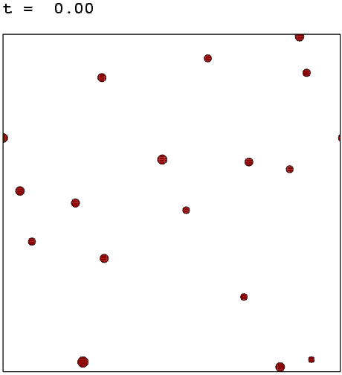
A typical level set simulation

Slide 14
Variation of adsorption and transition energy (no strain yet)
Kinetic limit
Thermodynamic limit
E_{trans}
E_{trans}
E_{ad}
E_{ad}
Nucleation in region of fast diffusion
Nucleation in region of slow diffusion (but high adatom concentration), dominated by drift
Nucleation rate ~

Slide 15
Ordering by Cleaved Edge Overgrowth
Work of E. Uccelli, G. Abstreiter, et al.
Grow AlAs/GaAs superlattice Cleave and rotate Grow InAs quantum dots
Quantum dots grow on top of the AlAs stripes
Hypothesis: Variations of the PES between AlAs and GaAs surface lead to ordering
We can test this with simulations

Slide 16
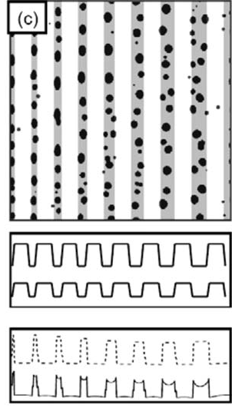

Ordering by Cleaved Edge Overgrowth
Experimental Result
Simulations
PES
Nucleation rate
X. B. Niu, E. Uccelli, A. Fontcuberta i Morral, and C. Ratsch, APL 95 (2009)

Slide 17
Include Strain: Calculate Elastic Field at Every Timestep
Our Model: Write down an atomistic energy density, that includes
Nearest neighbor springs
Diagonal springs
This can be related to (and interpreted as) continuum energy density
Minimize energy with respect to all displacements: ∂_{u} E [u] = 0
The relevant microscopic parameters at every grid point are then varied as a function of the local strain, according to the strain dependence calculated by DFT

Slide 18
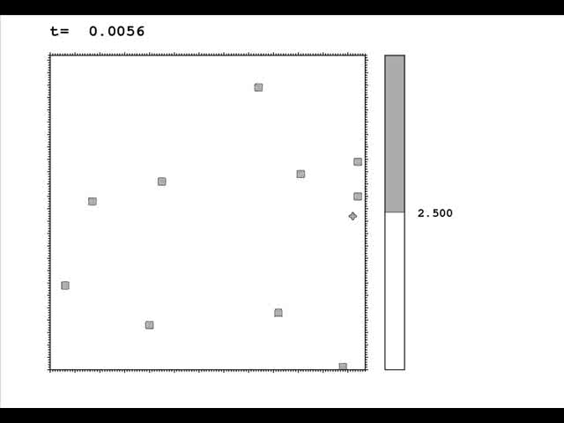
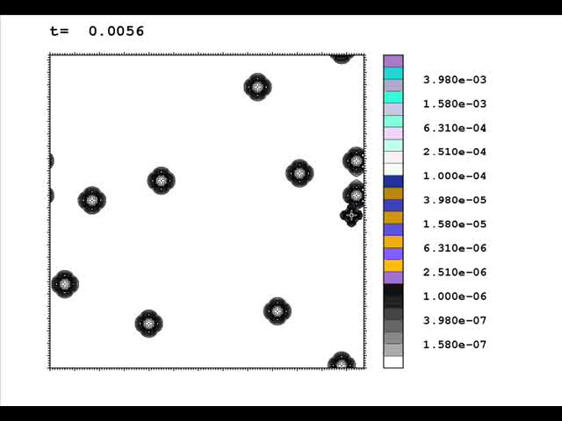
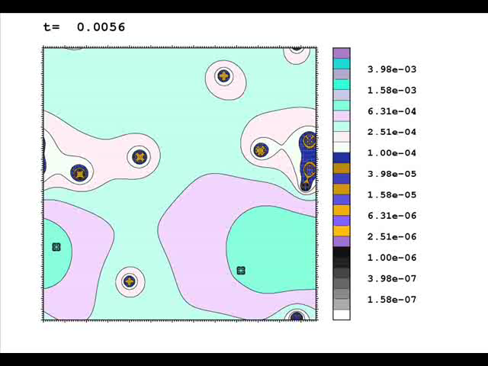
Effect of Strain in the Simulation
Morphologies
Elastic energies
Adatom concentration

Slide 19
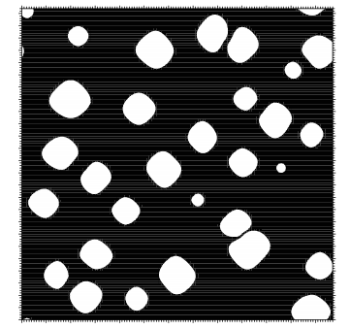
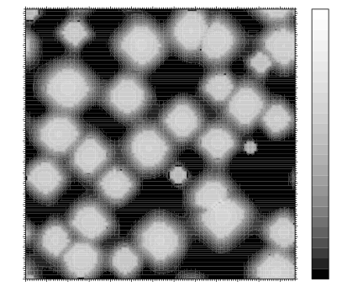
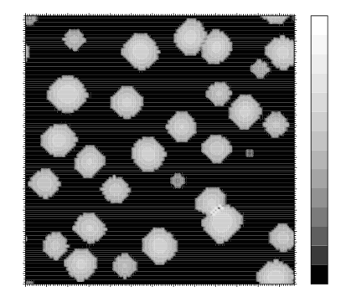
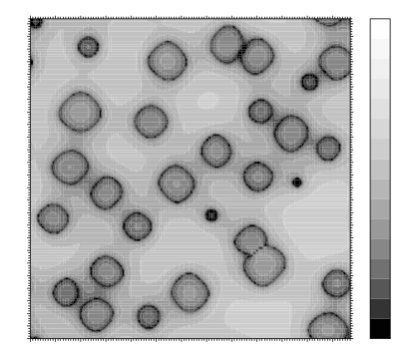
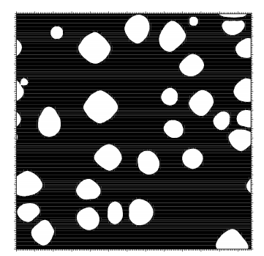
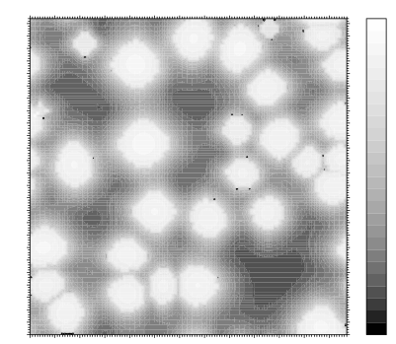
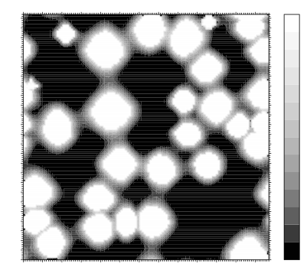
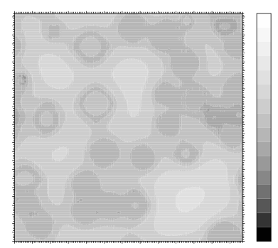
Effect of Strain in the Simulation
Morphologies
Elastic energies
Detachment rate
Adatom concentration
Top row: Compressive strain=1%
Bottom row: Compressive strain=5%
With increasing compressive strain, islands become more regular, because i) small islands are more likely to break up, and ii) growth of large islands slows down.

Slide 20
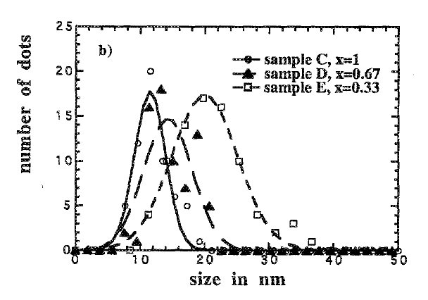
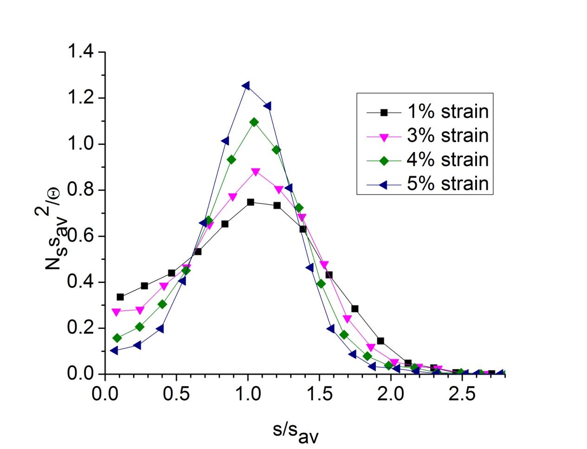
Sharpening of the Scaled Island Size Distribution during Submonolayer Epitaxy upon Compressive Strain
Level-set Simulation
Experiment: In_{x}Ga_{1-x}As/GaAs(100)
7% misfit
4.7% misfit
2.3% misfit
C. Ratsch, J. DeVita, and P. Smereka, Phys. Rev. B 80, 155309 (2009).
D. Leonard, M. Krishnamurthy, S. Fafard, J.L. Merz, and P.M. Petroff, J. Vac. Sci. Tech B 12, 1063 (1994)

Slide 21
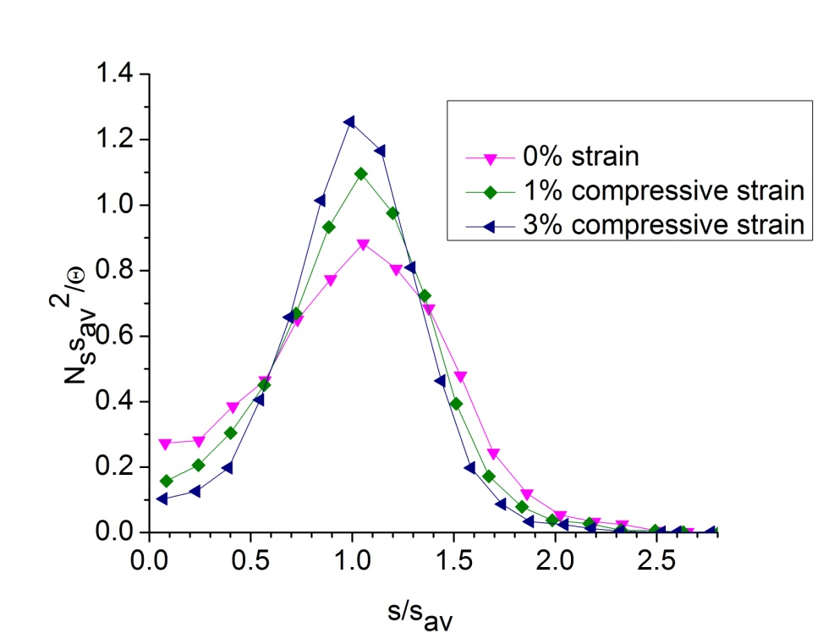
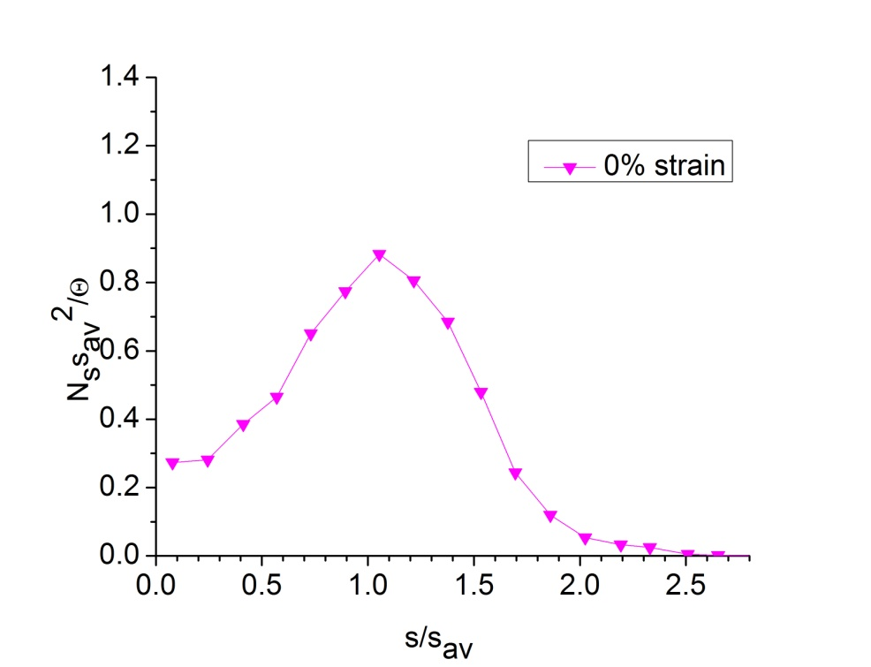
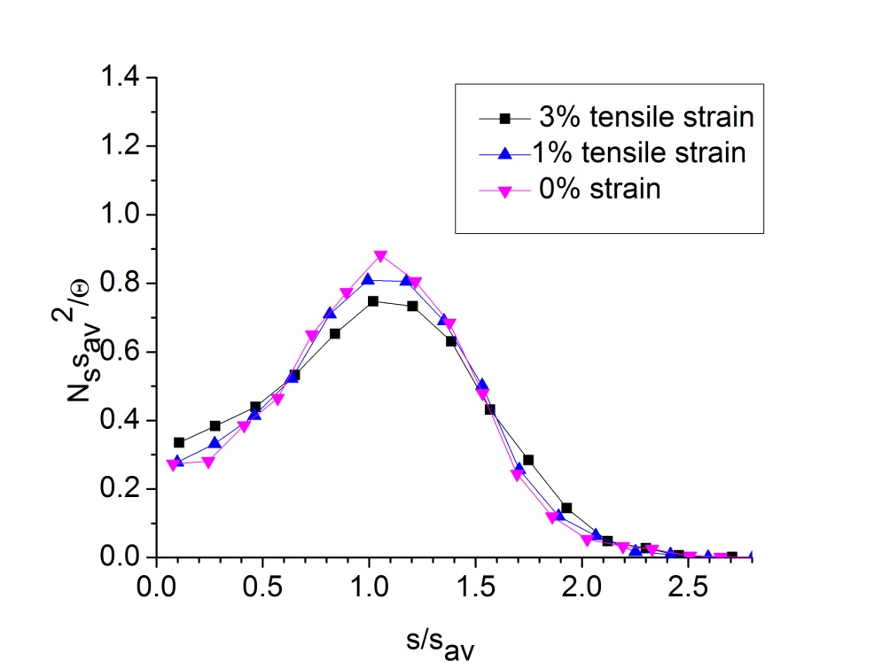
Scaled Island Size Distribution: Compressive versus Tensile Strain
Compressive strain leads to sharpening of ISD (dimer dissociation is enhanced)
Tensile strain leads to broadening of ISD (dimer dissociation is supressed)

Slide 22
Outline
Use density-functional theory (DFT) to calculate strain dependence of microscopic parameters.
The level-set formalism to model epitaxial growth.
Ordering in the submonolayer growth regime.
Ordering of stacked quantum dots.

Slide 23
Simulation of Stacked Quantum Dots
Al_{x}Ga_{1-x}As system
Experimental observation: Stacked quantum dots align under certain conditions
Question/goal: can we understand and model this, and make some predictions and suggestions?
B. Lita et al., APL 74, (1999)

Slide 24
Simulation of Stacked Quantum Dots
a
b
a
b
a
Growth of islands on substrate without strain (constant diffusion and detachment)
Fill in capping layer “by hand”
Calculate strain on top of smooth capping layer
Modify microscopic parameters for diffusion and detachment) according to strain
Run growth model
Repeat procedure
Repeat Capping and Growth of N Super layers
n capping layers of Si
Ge
Si Substrate

Slide 25
Ordering of Stacked Quantum Dots
Al_{x}Ga_{1-x}As system
B. Lita et al., APL 74, (1999)
Spacing and size of stacked dots becomes more regular
X. Niu, Y.-J. Lee, R.E. Caflisch, and C. Ratsch, Phys. Rev. Lett. 101, 086103 (2008).

Slide 26
Nucleation Rate as a Function of Capping Layer Thickness
60
60
30

Slide 27
Simulation of Growth of 20 Superlayers

Slide 28
Regularization of Dot Size

Slide 29
Ordering of Stacked Quantum Dots (Top View)
Growth of stacked quantum dots of In_{0.5}Ga_{0.5}As/GaAs(100)
2 periods
7 periods
9 periods
V.V. Strel’chuk et al., Semiconductors 41 (2007)

Slide 30
Conclusions
We have used DFT to calculate the strain dependence of adatom diffusion, dimer dissociation, edge diffusion, and detachment from island boundaries for Ag on Ag(100).
We have developed a numerically stable and efficient island dynamics model that includes the effect of strain on all microscopic parameters that are relevant during epitaxial growth.
We find that compressive strain leads to sharpening of the scaled island size distribution, while tensile strain leads to broadening.
We have modeled the aligned of stacked quantum dots.
Ongoing work: Include step-edge barrier, via a Robin Boundary condition, and study effect of strain on the uphill current

Slide 31


